Slide 1
SOR4D programme
Information meeting
05 December 2022, 14:00-15:30h CET, online

Slide 2
Agenda
Item | Who
Presentation of key characteristics of the SOR4D programme and funding | David Svarin
Your questions and our answers | Anne Jores David Svarin
Please type your questions in the chat during the presentation. We will answer them in bundles.
Meeting end: 15:30h
Notes:
This is our agenda.
First, I will present you the SOR4D programme.
In a second part, we will have a Q&A session. You are invited to post your specific questions in the meeting chat and we will answer them later on. Most of the individual questions that came in through the registration form have already been answered beforehand.

Slide 3
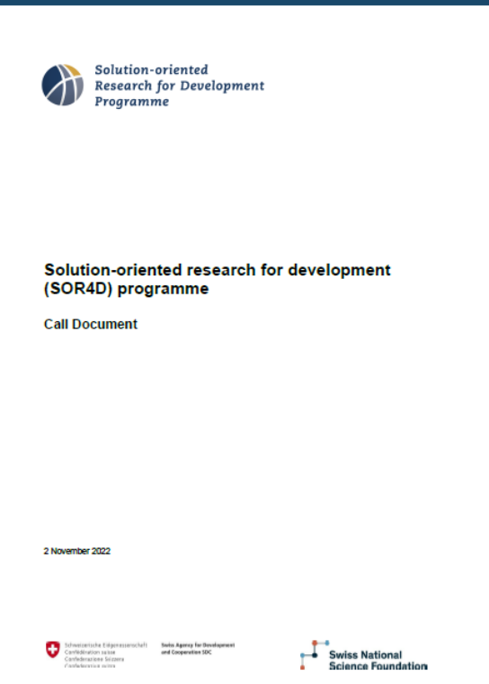
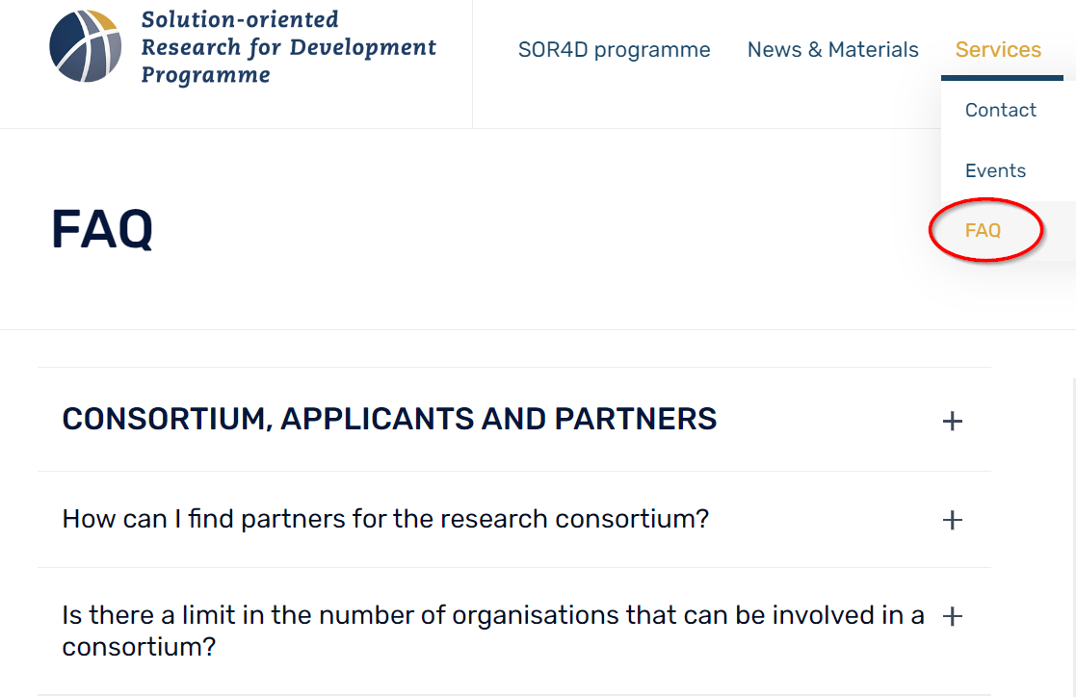
SOR4D website and call document
www.sor4d.ch
Notes:
Before I start the presentation, I would like to remind you of our SOR4D website: www.sor4d.ch, where you can access the call document, containing all the relevant information in relation to the progamme and the call.
On the website, there is also a FAQ section, which I invite you to consult for some of the more general questions reaching us frequently.

Slide 4
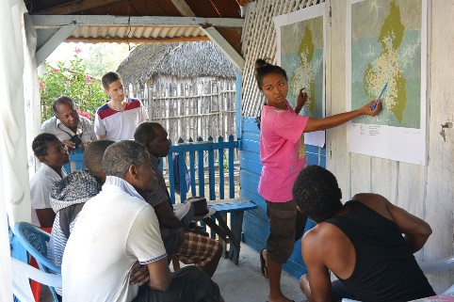
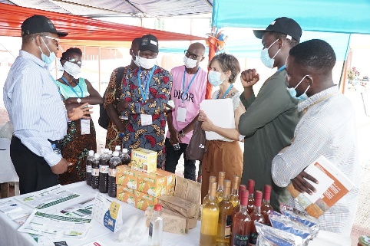
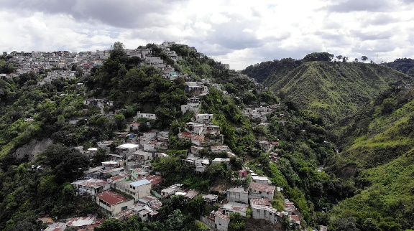

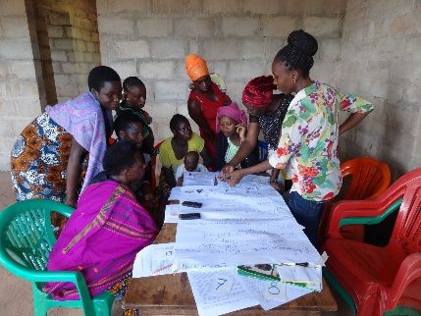
Key characteristics of the SOR4D programme
Notes:
Alright, here we go. You might have read the SOR4D call (which contains all the elements we’ll discuss today) or already checked out our website at sor4d.ch, but nonetheless I would like to provide you with a brief presentation of the main characteristics of the SOR4D programme.

Slide 5
SOR4D programme goal
The overarching goal is to produce better knowledge, solutions and innovation by needs-driven, transdisciplinary research that opens up new ways for advancing sustainable development and reducing poverty in the least developed, low and lower middle-income countries.
The SOR4D programme strives to contribute to the implementation of the 2030 Agenda by fostering partnerships, co-creation of knowledge and innovation.
Notes:
So, to repeat what the SOR4D is all about: the principal goal of the programme is to produce better knowledge, solutions and innovation by needs-driven, transdisciplinary research that opens up new ways for advancing sustainable development and reducing poverty in the least developed, low and lower middle-income countries.
In doing so and by fostering partnerships, co-creation of knowledge and innovation, the SOR4D programme also strives to contribute to the implementation of the 2030 Agenda.

Slide 6
SOR4D programme objectives
Researchers and development actors jointly generate needs-based, solution-oriented knowledge that contributes to sustainable development and poverty reduction in the Global South and East.
Project partnerships and networks will test and disseminate research results with potential for innovation. This will include different forms of upscaling.
Researchers and development actors will enhance their competences in conducting solution-oriented transdisciplinary research in partnership. This includes sharing their findings with other academics and practitioners.
Notes:
In deduction from the overarching objective, the SOR4D programme has three specific objectives:
1) Researchers and development actors will jointly generate, in their respective geographical contexts, needs-based, solution-oriented knowledge that contributes to sustainable development and poverty reduction in the Global South and East. This includes validation in those contexts, where the research took place.
A second objective relates to competences and skills development: Researchers and development actors will enhance their competences (skills and know-how) in conducting solution-oriented transdisciplinary research in partnership. This also means that systemic and complex development challenges are addressed and for that it is essential that findings are shared with other academics and practitioners.
Finally, the third objective is targeting the testing and dissemination of research results with potential for innovation. With that the focus is on extending the partnerships and networks and try to scale up some of the solutions you might come up with in your research, through pilot testing, valorization and other forms of upscaling.

Slide 7
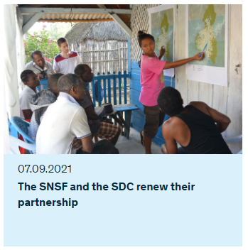
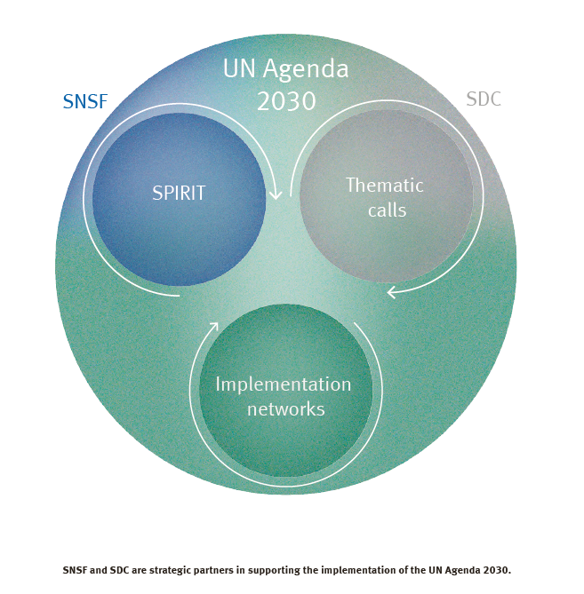
Partnership SDC-SNSF 2021-2024/2030
Memorandum of Understanding (MoU) between SDC and SNSF signed in January 2021.
SDC and SNSF coordinate their funding efforts for cross-border research partnerships with developing countries, including activities for the dissemination and utilisation of research results in all sectors of society.
Source: SNSF Multi-Year Planning 2021-2024, Strategic priorities, p. 33
Notes:
The SOR4D programme is a partnership programme sponsored by the Swiss Agency for Development and Cooperation and the Swiss National Science Foundation. They have signed a new partnership for this decade, where they announce that they would like to coordinate their funding efforts for cross-border research partnerships with developing countries and especially also for disseminating and making use of research results for the benefit of society.

Slide 8

Research with OECD DAC* countries (Swiss programme and project funding)
1990 | 1995 | 2000 | 2005 | 2010 | 2015 | 2020 | 2025 | 2030
Scientific co-operation between Eastern Europe and Switzerland (SCOPES)
Research partnerships with Developing Countries SNSF-SDC
NCCR North-South
SDC-SNSF r4d programme
SOR4D programme SDC-SNSF
SNSF SPIRIT
Bilateral programmes
*Development Assistance Committee, annual list of low- and middle-income and least developed countries
Notes:
This partnership is a continuation of a long term partnership between these two institutions, they have been cooperating in different ways, for many years and decades.
The two last expressions of this are the r4d programme that has been running for 10 years and is still running until the end of this year and then this new solution-oriented research for development program which has a duration of five years and, hopefully, a bit longer.
The focus of the funding that is provided in the SOR4D is on international collaborations between researchers and development actors from least developed, low and lower middle income countries and Switzerland.

Slide 9
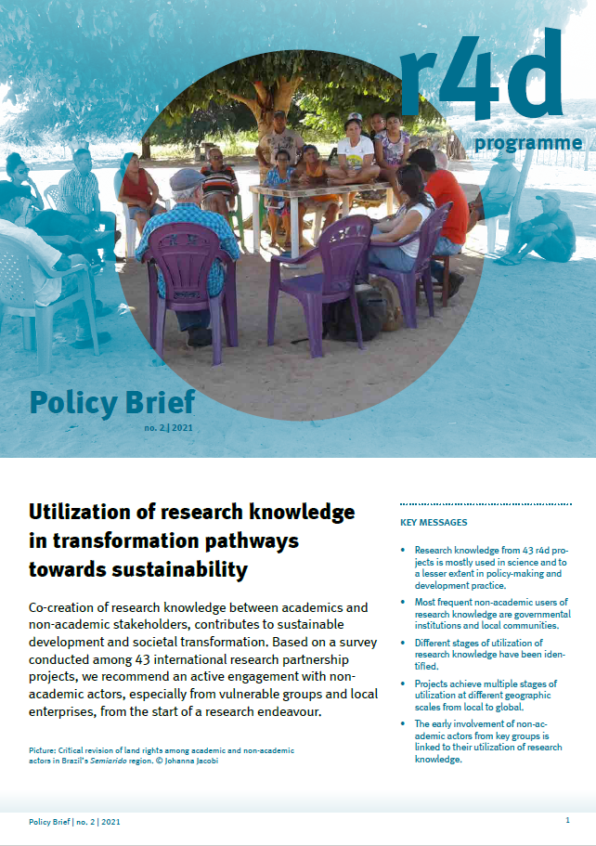
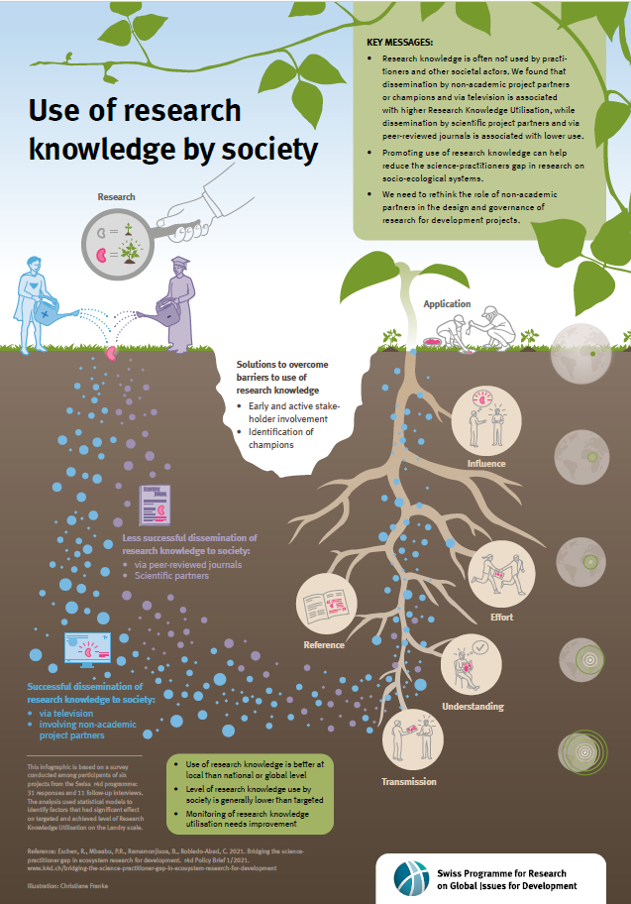
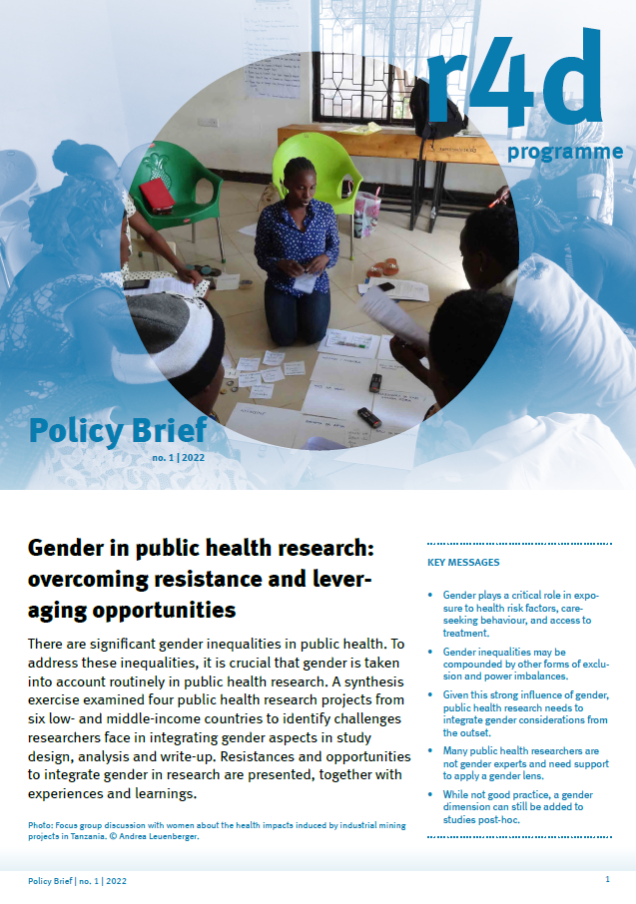
Focus of SOR4D programme funding
international collaborations between researchers and development actors from least developed, low and lower middle income countries and Switzerland
transdisciplinary projects only
gender awareness and equal opportunities to be taken into account throughout the research and project implementation process
Notes:
You see below a policy brief that emerged from the r4d programme where exactly this use-inspired and transdisciplinary nature of this kind of research collaboration is addressed and how this can contribute to sustainable impact pathways for transformation
In the SOR4D programme, only transdisciplinary projects are funded. We aim with this program towards a better use of research and knowledge by society and knowledge that is being produced in partnership with practice partners. There is a strong focus also on gender awareness and equal opportunities that has to be taken into account throughout the research and implementation of the research projects.

Slide 10
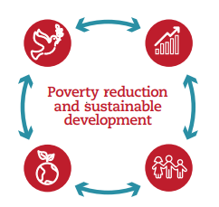
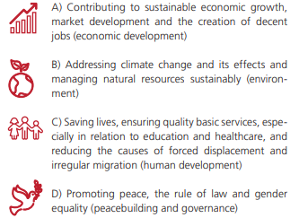
SOR4D topical focus
open to all disciplines from the humanities, social sciences, natural sciences, engineering, health and life sciences.
encourages interdisciplinary collaboration between research domains where such collaboration is appropriate
explicit aim for systemic and transformative solutions that simultaneously address several of the 17 SDGs
Orientation in the broad spectrum of the 2030
Agenda give the four objectives of Switzerland’s
International Cooperation Strategy.
Notes:
In terms of focus the SOR4D programme is quite large. It is open to all disciplines from the humanities social sciences natural sciences engineering health and life sciences.
It encourages also interdisciplinary collaboration between the research domains, for example between humanities and engineering or social sciences and health sciences. These kind of combinations are very welcome.
There is a specific aim for systemic and transformative solutions that simultaneously address several of the 17 SDGs.
Since the programme is sponsored by Swiss public funding, your research proposals can find orientation in these 4 broad objectives of Switzerland’s
International Cooperation Strategy.

Slide 11
SOR4D programme budget
Total programme budget: CHF 19.3 million
Research funds: CHF 17.2 million
(preparatory grants, project budgets, Transformation
Accelerating Grants, events and communication)
Management funds: CHF 2.1 million
(evaluation and monitoring, programme management,
communication)
Number of projects to be funded: approx 20
Two Calls: 1st call Feb 2022 and 2nd call Nov 2022
Notes:
The SOR4D programme has a total budget of 19.3 million. With this we aim to fund around 20 projects.
There are two calls that are being launched. One call has already been closed and is currently in the evaluation phase and the second call that is open now has a submission deadline for Pre-proposals on February, 13th.
Again, let me just draw your attention to the SOR4D call document, where you’ll find all these information and the time schedule.

Slide 12
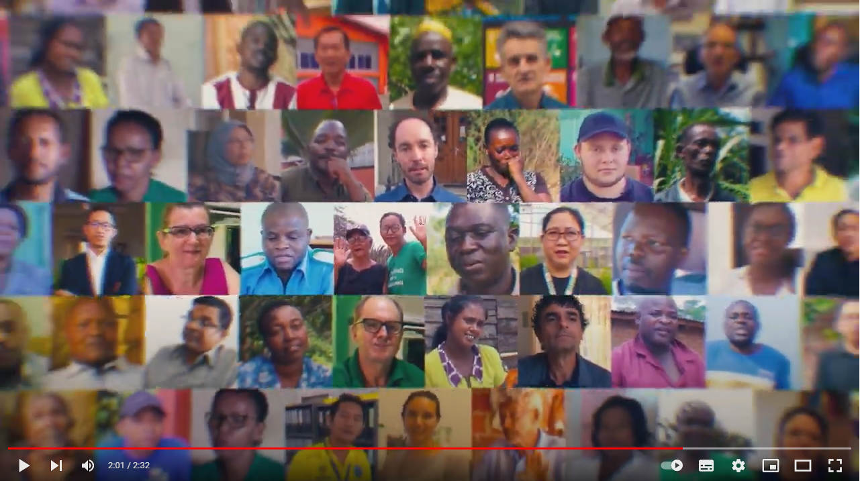
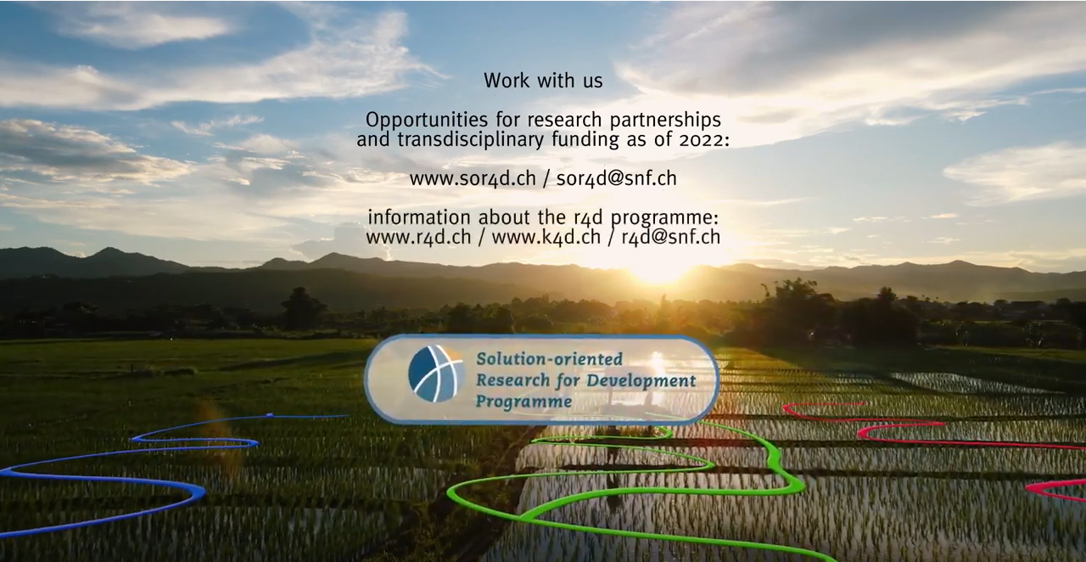
Notes:
With this, this is a picture from the SOR4D programme trailer which was produced based on footage that we collected in the numerous r4d projects. You see here a group of researchers that have been collaborating with us in the r4d programme. And this is really a transition phase now between the ten-year r4d programme, which had similar objectives, and this new solution-oriented research for development programme.

Slide 13
Project examples from the r4d programme
Notes:
Some of you have provided comments in the registration for this event and one of them was that we should provide a couple of examples of projects that might fall into the funding scope of the SOR4D programme.
We provide three project examples for you to find some inspiration. But you are of course invited to come up with innovative and inspiring and unconventional new ideas.

Slide 14
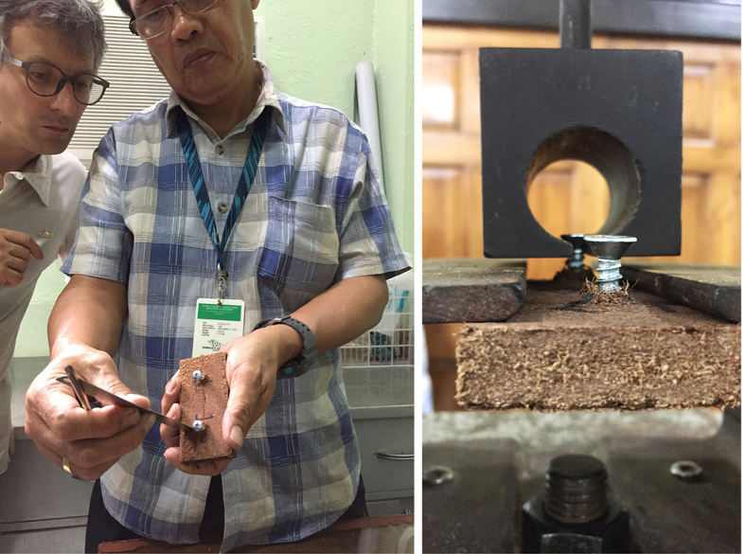
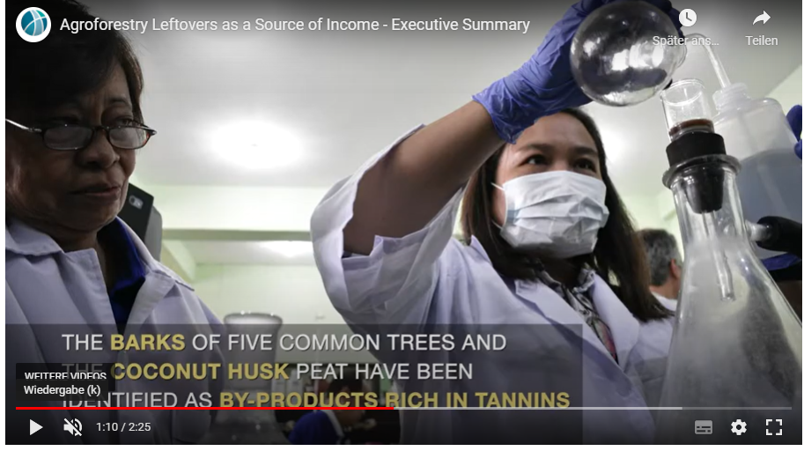


Project examples 1: r4d COCOBOARDS (2014-2017)
COCOBOARDS TAG (2019-2020)
r4d Pinoy Tannin (2018-2022)
COCOBOARDS developed and implemented an environmentally sound technology for the manufacturing of affordable building materials made of coconut husk and bonded with tannin-based adhesive. The project and TAG target local production for local supplies.
The Pinoy Tannin project aims to develop the scientific, technological, social and economic bases to set up a sustainable and environmentally-friendly tannin extraction value-chain in the Philippines, and to contribute to the creation of new revenue possibilities for local communities.
→ NaturLoop is a Swiss-based green tech and materials science startup.
Notes:
So the first example I would like to present is the project Cocoboards.
Cocoboards was a research partnership between Switzerland and the Philippines. It was very much focused on technical innovation and based on coconut husk they developed and invented construction material.
Cocoboards was a three year project in the r4d programme and in another open call of the r4d programme almost the same consortium applied for a project called Pinoy Tannin, another technological project that was very much related to Cocoboards and is also implemented as partnership between Switzerland and the Philippines.
Cocoboards also benefited from the Transformation Accelerating Grants call, that was launched in 2019.
The TAGs were an expression of interest from the r4d researchers that the r4d programme should provide funding for testing results and for taking results further. So we opened up a new call and Cocoboards was amongst the first ones to implement also such a TAG initiative.
From this group, Naturloop, a Swiss-based green tech materials science startup emerged. Natureloop has in the meantime also received funding from other startup fund, from other partners and they are thriving now as a start-up in close collaboration with the Philippine partners.

Slide 15
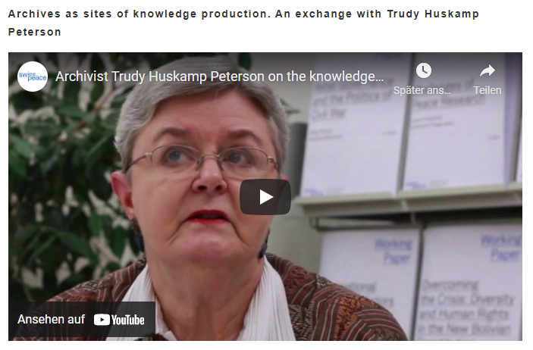

Project examples 2: r4d Knowledge for Peace http://knowledge-for-peace.org/
“Knowledge for Peace. Understanding research, policy and practice synergies” aimed to improve peacebuilding practice by looking at how research and knowledge about peace and its components are generated and how the politics of knowledge production impact policy making. The project focused on transitional justice processes in Côte d’Ivoire, South Sudan and Mozambique.
Notes:
A second example that is more from the social sciences and humanities. This project, which is called “Knowledge for peace”, is really relevant in the current context.
The project looked into the production of knowledge and how memories are archived and presented. They were thus looking into transitional justice processes in countries where conflicts are very severe and they have been looking into possibilities for remembrance.

Slide 16
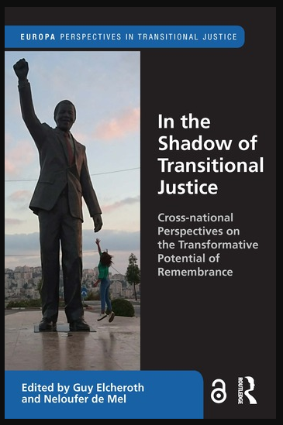
Project examples 2: r4d Knowledge for Peace http://knowledge-for-peace.org/
“Knowledge for Peace. Understanding research, policy and practice synergies” aimed to improve peacebuilding practice by looking at how research and knowledge about peace and its components are generated and how the politics of knowledge production impact policy making. The project focused on transitional justice processes in Côte d’Ivoire, South Sudan and Mozambique.
Project examples 2:
Fostering Pluralistic Memories and Collective Resilience in Fragile Transitional Justice Processes
https://wp.unil.ch/pmp/
Notes:
We have another project that was in a similar direction, a project that was implemented by social psychologist and anthropologists. They looked very much into archiving, into remembrance, they also worked a lot with arts to also address trauma.
So these are two interesting examples that are more from the social sciences, humanities and arts.

Slide 17
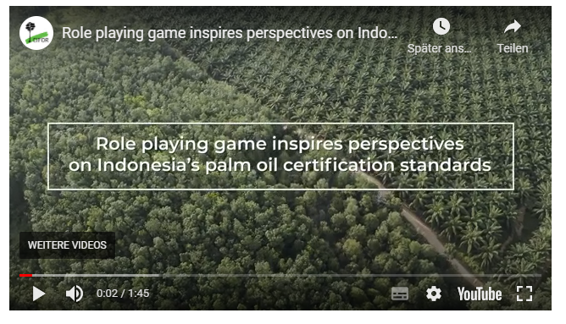
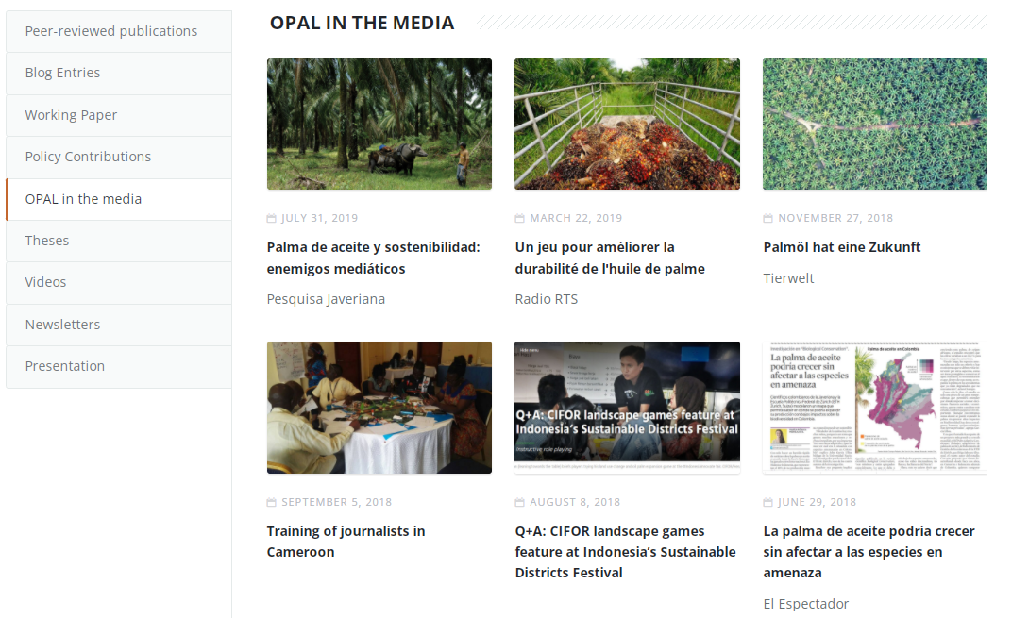
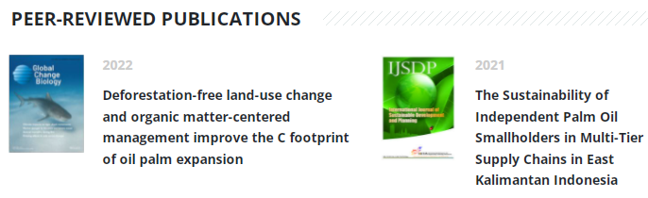
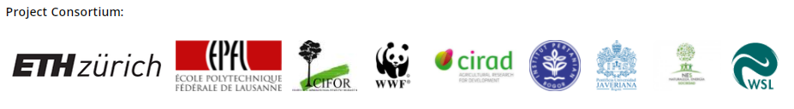
Project examples 3: r4d Oil Palm Adaptive
Landscapes https://www.opal-project.org/
The OPAL Project was implemented from March 2015 until May 2021 in Cameroon, Colombia, Indonesia and Switzerland.
Using disciplinary research as well as participatory and transdisciplinary approaches such as role-playing games, we have been enhancing knowledge on oil palm landscapes and fostering dialogues that could lead to shared solutions across perspectives and complexities.
Notes:
The third project is the “Oil palm adaptive landscapes” project.
It’s dealing with oil palm production and was looking for solutions for more sustainable palm oil production.
You see below a consortium made up of research partners, including implementing partners such as WWF. This was a rather big consortium that worked together for six almost seven years.
They have produced a lot of scientific papers, but they have also produced more such as videos, policy briefs and other communications products to be used in the policy arena and with stakeholders on the ground.
This has been a truly transdisciplinary project right from the beginning. The project consortium was already composed of researchers and practitioners and they have jointly created a lot in terms of output, but also in terms of networks, policy dialogue and in terms of practice development.
Have a look at these projects if you like to be inspired, but also if you would like to see what can be done in projects of different durations and projects that manage to receive additional funding from other calls.

Slide 18
SOR4D eligibility of mixed consortia and project funding
Notes:
Coming now to more technical aspects, but I think this is what you are also very much interested in hearing about. Namely, how the SOR4D programme is structured, how the mixed consortia are composed and how project funding is supposed to be implemented.

Slide 19
International and transdisciplinary consortia
*= Minimum required composition of consortium
*Switzerland
Research partner
*Partner country
Research partner
*Partner Country
Development actor
Partner country
xy
Partner Country
xy
According to the SNSF Funding Regulations, the responsible applicant (= Swiss Research Partner) must be employed at a Swiss higher education or research institution and must be able to show that the project can be administered in service of the full consortium of co-applicants at a Swiss higher education or research institution during the entire project duration.
The responsible applicant is responsible for submitting the pre-proposal and full proposal in the name of the full consortium of co-applicants.
Sub-contractor/ Project partner Global North/CH Development partner
International transdisciplinary research partnerships require skilful coordination. Project coordination can be assumed by members of partner institutions or by the Swiss institution.
Adequate funding for coordination has to be budgeted for these positions.
Notes:
So, first of all, this is a research partnership program between Switzerland and ODA recipient countries.
Because of SNSF funding regulations the Swiss research partner has a special role as responsible applicant for the full team, for the full consortium. This person that is based at a Swiss Higher Education and Research Institution will submit the pre-proposal and full proposal in the name of the full consortium of applicants.
The full consortium of applicants consists of a Swiss research partner and a research partner from a partner country, that is from a ODA recipient country and a development actor, which means a practice partner from this country. This is the minimum required composition of the consortium.
We have seen that it is of high benefit that the research partnership is not only bilateral between Switzerland and another partner country, but if more partner countries are part of the consortium. Because for exchange, for knowledge and learning this seems to be highly relevant. But it is not the condition, so you can add more partner countries, but you can also only have one partner country between Switzerland and the partner country.
In addition to that minimum consortium, you have also the possibility to include as project partner or subcontractor, development partners from the global north or Switzerland. However, they are not eligible as co-applicants, but they can be part of the consortium as project partner in well-justified cases.
We have seen that these kinds of projects require quite a lot in terms of coordination. Especially when they are transdisciplinary right from beginning, the coordination is an important element in in these projects. And we have also seen that a lot of our partners that we fund in the partner countries outside Switzerland, have built their skills to become active in project coordination and project management. So in the SOR4D programme, it is possible that the project coordination is not done in Switzerland, but can be done in one of the partner countries. Indeed, it is a shared responsibility. Therefore, adequate funding for these positions have to be budgeted. These funds are there, so please make use of these funds for coordination tasks, they can really be instrumental for these kinds of projects.

Slide 20
Financial conditions
*= Minimum required composition of consortium
SOR4D global project budget (500’000 – 1’000’000 CHF)
*Subproject Switzerland
Research partner
*Subproject
Partner country
Research partner
*Subproject
Partner country
Development actor
Subproject partner country
xy
Subproject partner country
xy
max. 50% in CH
min. 50% in partner countries
Sub-contractor/ Partner Global North/CH
Development partner
min. 20% for development actors
min. 10% on communication
Notes:
Coming to the financial aspects now. As you might have read in the call document, a project can have a global budget between 500,00 and 1 million Swiss francs. And very importantly, there are three financial conditions that apply in the SOR4D programme.
The first condition is that at least 50% of the total budget has to be spent in the partner country or partner countries. So we we'd like to see a good spending level in the partner countries, because this is where the focus of the solution-oriented research for development programme lies.
The second condition is that a minimum of 10% of the global budget has to be spent on communication. As you know, in a transdisciplinary set-up with a consortium of mixed partners, communication has to start right from the beginning.
And then the third condition is that we would like to see a very active role of the development actors who are based at practitioner organizations. These are the actors that are in the position to make use of emerging research results, co-created knowledge and those that are in a position also to validate and valorize this knowledge, these findings in the in the respective local context or national contexts. So this is why there is a third financial condition, namely that a minimum of 20% of the global budget needs to be allocated to these development actors.

Slide 21
SOR4D project funding
3 years
1 year
Transdisciplinary research project
CHF 500’000 – 1’000’000
Transformation Accelerating Grant
ca. 100’000
With the project duration of three years, the SOR4D programme addresses mostly post-doc and senior researchers with a high interest in working towards practical solutions.
Notes:
Coming now to project funding.
SOR4D projects have a duration of three years. And because of this limited duration, it is mostly addressing postdoc and senior researchers and is not made for big groups of PhD students that can be part of that project. Why is this so? We want to start these projects really soon, so that they can be implemented right away and that you don't need to find collaborators, but you already have the collaborators at the stage of a full proposal submission.
There is a one-year extension that is granted in the form of a Transformation Accelerating Grant, which means that additional funds will be provided to successful project consortia.

Slide 22
SOR4D project funding (3 years + 1 year)
3 years
1 year
Transdisciplinary research project
Transformation Accelerating Grant
Final project report
(3 years)
1st progess report
2nd progess report
as TAG proposal
Final project report (4 years)
Evaluation of Transformation Accelerating Grant (TAG) proposal by SOR4D Review Panel
Funding decisions for TAG, i.e. four project years
Phasing-out decision, i.e. three project years
Notes:
So, what does this mean in terms of sequencing?
Once you have a successful project and you started with it, after some time you will have to submit the first progress report. Then you submit the second progress report, which simultaneously acts as a Transformation Accelerating Grant proposal and a one-year extension of your project. This report or proposal will be evaluated by the SOR4D review panel and the funding decision will be either for a fourth year or it will be a phasing-out decision for the project after three years.
So this just you get a sense of the mechanism and what comes after a successful full-proposal submission and funding decision.

Slide 23
Evaluation procedures and SOR4D Review Panel
Notes:
Now let’s have a look at the evaluation procedures and the SOR4D review panel.

Slide 24
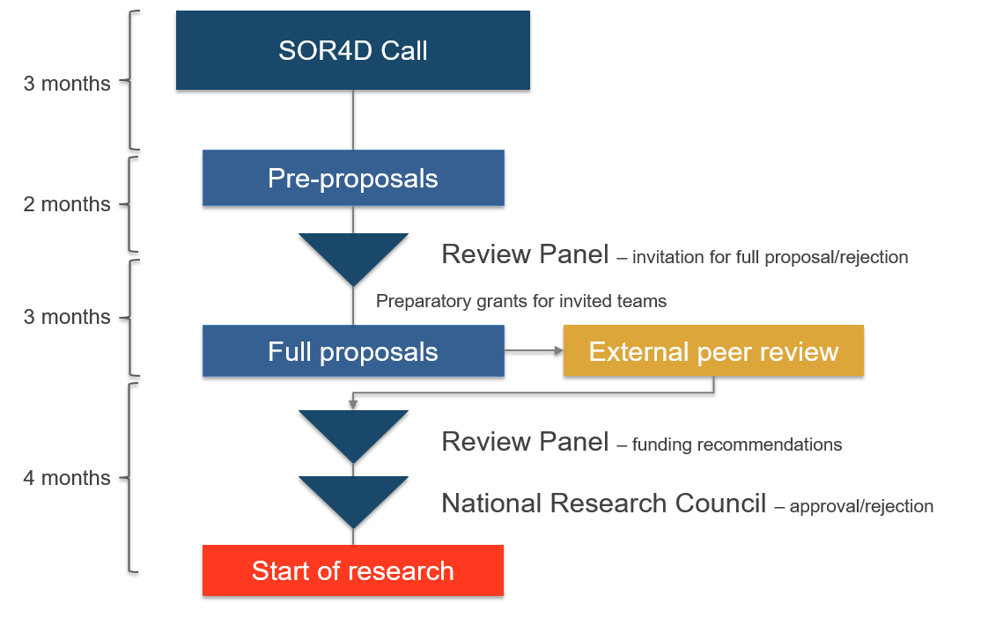
Evaluation procedure
Notes:
You have seen this graph already in the call.
Right now, you are in the stage of preparing pre-proposals. The pre-proposals that are being submitted until mid February, will be reviewed by the review panel. The review panel will evaluate these pre-proposals and we'll invite selected pre-proposals to be elaborated into full proposals.
Those who are invited to submit full proposals can apply for preparatory grants. The full proposals will then be submitted in the end of August. They will be externally peer-reviewed and the review panel will evaluate the full proposals, based on the external reviews and their own evaluation to come up with funding recommendations.
These funding recommendations, which can either be an approval or a rejection, will be formally approved or rejected by the National Research Council and its Presiding Board. These meetings are scheduled for January 2024 and we expect the successful projects to be ready to start sometime around May 2024.

Slide 25
Evaluation criteria
Scientific quality and relevance for development are of equal importance for projects funded in the SOR4D programme. Pre- and full proposals will be reviewed and evaluated based on the following criteria:
Significance, originality and topicality of the project;
Adequate participation of professional practitioners and publics (including end-users) in all project stages;
Suitability and feasibility of the systemic approach and methods chosen;
Applicants’ track records in the fields of the proposed transdisciplinary research, complementary expertise and shared responsibilities within a mixed consortium;
Proposal addresses important sustainable development and poverty alleviation needs in one or several ODA recipient country/countries;
Proposal has an explicit theory of change and a clear logical framework reflecting the actual body of knowledge;
Proposal suggests adequate measures to effectively promote the use of research knowledge and potential for research finding uptake;
Proposal demonstrates awareness for gender, intersectionality and social inclusion and how it will be ensured throughout the research process.
Notes:
Let’s come to the evaluation criteria.
Like in our earlier program, the r4d programme, scientific quality and relevance for development are of equal importance for the projects that are funded in the SOR4D programme. What you see here is a long list of eight criteria that were developed based on the discussions we had between SNSF and SDC, and also with the review panel members and the National Research Council.
The list is a bit longer than in our normal funding schemes, but with these eight criteria both the reviewers as well as the review panel members and the National Research Council are in a good position to evaluate these transdisciplinary research partnership projects.

Slide 26
Evaluation and funding recommendations
Pre-proposals are evaluated by the Review Panel who will award marks.
Full proposals are reviewed by international peer experts. Based on these reviews and their own evaluation, the Review Panel will award marks.
The range of awardable marks according to the Unified Evaluation Procedure of the SNSF ranges from 1 (low quality) to 9 (high quality).
If proposals are rated as equivalent, proposals submitted by female applicants or proposals that show a better gender balance in the applying team (responsible applicants and co-applicants) will be given priority.
If proposals are still rated as equivalent, proposals with more responsibility in the ODA recipient countries will be given priority.
Notes:
In this two-stage process, the review panel and external experts will mark your pre-proposals and full proposals according to a range from one to nine. This means that all of them will use this range and give a mark for each of the eight criteria that were showed on the previous slide. In doing so, the review panel has a good basis for discussion.
If proposals are rated as equivalent, proposals submitted by female applicants or proposals that show a better gender balance in the applying team (responsible applicants and co-applicants) will be given priority.
If proposals are still rated as equivalent, proposals with more responsibility in the ODA recipient countries will be given priority.

Slide 27
SOR4D Review Panel Composition
Review Panel composed of a total of around 10 scientific and development experts who are mandated for the full programme duration (i.e. 2021-2026). At pre-proposal evaluation stage they can be supported by ad-hoc panel members. Review Panel members are elected by the National Research Council and its Presiding Board. The SOR4D Review Panel is trained by the SNSF for fair evaluation. Conflict of interest is avoided at any stage.
Composition of the Review Panel:
Multidisciplinary and international composition of the Review Panel, including members from developing and emerging countries
Independence of members
Extensive work and/or research experience in developing countries/with development issues and interest in transdisciplinarity
A minimum of 40% female members (SNSF Quota)
Members with no interest to apply to the calls
In addition to the elected scientific and development experts:
One SNSF Delegate acts as evaluation meeting chair and spokesperson of the Review Panel.
One or two SDC Delegate(s) act as referee(s) and fully participate(s) in the evaluation of the pre-proposals and proposals as well as monitoring.
Notes:
OK, now some information about the review panel. It consists of eight scientific and development experts who are mandated for the full program duration. If we receive a high number of pre-proposals or if we see that pre-proposals are submitted from disciplines or from areas, which cannot be covered by the eight experts, we will recruit ad-hoc review panel members, which will support the review panel in its evaluation. These ad-hoc panel members also need to be elected by the National Research Council and its Presiding Board, which demonstrates that we take tthis step very seriously.
The review panel is trained for fair evaluation and conflict of interest is avoided at any stage.
The composition of the review panel is such that it is a multidisciplinary panel, it is international and includes members from developing countries and from other countries. The members are independent and have no interest themselves in the call. Furthermore, they all have experience in working with developing countries or in development contexts and they have a big interest in transdisciplinary research. We have a review panel that has a very good gender balance.
Two delegates from the SNSF and SDC are part of the review panel. The SNSF delegate will act as chair and spokesman of the review panel and the SDC delegates are fully participating in the evaluation. The only difference is that they were not elected, but they were chosen by SDC to be part of that review panel.

Slide 28
SOR4D Review Panel Members
 | Prof. Dr. Valeria Esquivel, International Labour Organisation (ILO), Switzerland
 | Dr. Marjolein Dieleman, Royal Tropical Institute, Amsterdam, and VU Amsterdam, Netherlands
 | Dr. Smita Premchander, Sampark, Amhmedabad, Gujarat, India
 | Dr. Karen Holm Olsen, UNEP Copenhagen Climate Centre (UNEP CCC), Copenhagen, Denmark
 | Dr. Kristina Lanz, Alliance Sud, Switzerland
 | Prof. Dr. Cheikh Mbow, Future Africa, University of Pretoria, South Africa, and Michigan State University-Forestry, Lansing, USA
 | Prof. Dr. Bernadette Resurrección, Queens University, Canada
 | Prof. Dr. Dzodzi Tsikata, University of Ghana, Ghana
 | Prof. Leon Tikly, University of Bristol, England
 | Mirjam Macchi Howell, Swiss Agency for Development and Cooperation, Switzerland
 | Prof. Dr. Martin Lengwiler, University of Basel, Switzerland (deputy)
 | Prof. Dr. Stuart Lane, University of Lausanne, Switzerland (Panel chair)
Notes:
And on this slide you can see the eight review panel members and the three delegates that support the evaluation in the SOR4D programme.

Slide 29
SOR4D programme management
 | Dr. David Svarin, SNSF, programme manager
 | Dr. Anne Jores, SNSF, programme manager
 | Marie-Jeanne Khiari, SNSF, programme assistant
 | Mirjam Macchi Howell, SDC, Policy and Analysis
SOR4D Supervisory Body
 | Odile Robert, SDC, Head Policy and Analysis
 | Dr. Pierre Willa, SNSF, Head Programmes Division
Notes:
The SOR4D programme is managed at the Swiss National Science Foundation. The programme coordinators are my colleague Anne Jores and myself, David Svarin. Marie-Jeanne Khiari is our programme assistant at SNSF.
And our colleague at SDC, Mirjam Macchi, also has a very good understanding of this programme and can also support you in your questions, but also throughout the programme implementation.
There is a supervisory body of the SOR4D programme, which is composed of two representatives from SNSF and SDC, namely the Head of the SDC Policy and Analysis unit and the head of the thematic research division at SNSF.

Slide 30
Continue dialogue on…
An explicitly transdisciplinary research programme for development:
What is meant by transdisciplinarity (set-up, research process …)?
How to judge outcomes?
A solution-oriented programme:
Is it possible to produce solutions within the project timeframes?
What kinds of solutions are considered as “solutions”?
→ The SOR4D programme opts for a board range of definitions of transdisciplinarity and “solutions” and invites consortia to be very explicit about their contributions and their theories of change.
Notes:
So coming to an end of this introduction to the SOR4D programme, I want to share some general thoughts and pertinent questions with regard to some of the key elements of this new programme.
What does it mean to fund an explicitly transdisciplinary research programme? What is meant by transdisciplinarity? Is it about setup, is about the research process? How do we judge outcomes of transdisciplinary research projects?
These are questions about transdisciplinarity that cannot be easily and quickly answered. Therefore we share them with you today and this is certainly something that continues to be part of the dialogue that you might have with the SOR4D programme.
The second question concerns the solution orientation: is it possible to come up with solutions in the project timeframe of three to four years? What kinds of solutions are considered as solutions? In response to both questions, we really opt for a broad range of definitions and also for creativity.
So, when submitting your proposals, please convince us about your idea, the composition of your consortia, about your contributions and about your theories of change and be very explicit about that, because that will help a lot in making and developing the SOR4D programme together with you and with the SDC and SNSF.

Slide 31

Thank you for your interest in the SOR4D programme!
https://www.sor4d.ch
Notes:
Alright. With this I would like to thank you for your attention and for your interest in the SOR4D programme. We will now start the Q&A session and I will hand over to my colleague Anne who has collected some of the question from the chat. After this first round of answers, please do not hesitate to raise your hand electronically and ask your question in person.

Slide 32
Framework and budget of SOR4D programme
Programme duration: 2022-2026 (5 years)
Research duration: 3 years (transdisciplinary project) plus 1 year Transformation Accelerating Grant
Budget: CHF 19.3 Million
Research focus: Orientation on 4 strategic objectives of Switzerland’s International Cooperation Strategy (2021-2024) but thematically and geographically open with demonstrated contribution to 2030 Agenda for Sustainable Development and several 17 SDGs
Selection process: 2 stages (pre-proposals, full proposals)

Slide 33
Characteristics of SOR4D programme
Funding for transdisciplinary and interdisciplinary (across research domains) project set-ups only; open to all disciplines from the arts and humanities, social sciences, natural sciences, engineering, health and life sciences
Mixed consortia with academic actors from higher education and research institutions and development actors from practitioner organisations
Short research project phase of a maximum of 36 months with possibility for extension by 12 months Transformation Accelerating Grant; no funding for PhD students
Oriented towards needs-based knowledge, solutions and application for sustainable development and poverty alleviation in least developed, low and lower middle-income countries
Monitoring of project progress (i.a. openness to emergent issues) and monitoring of 3 financial conditions

Slide 34
Group work:
Assessing the potential of a solution-oriented research for development project

Slide 35
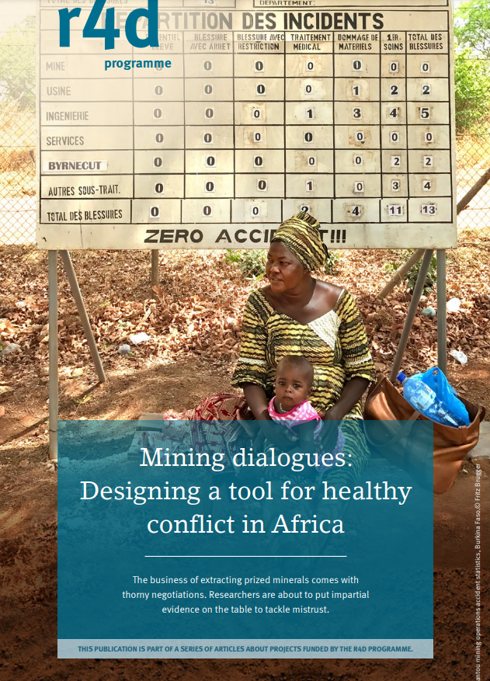
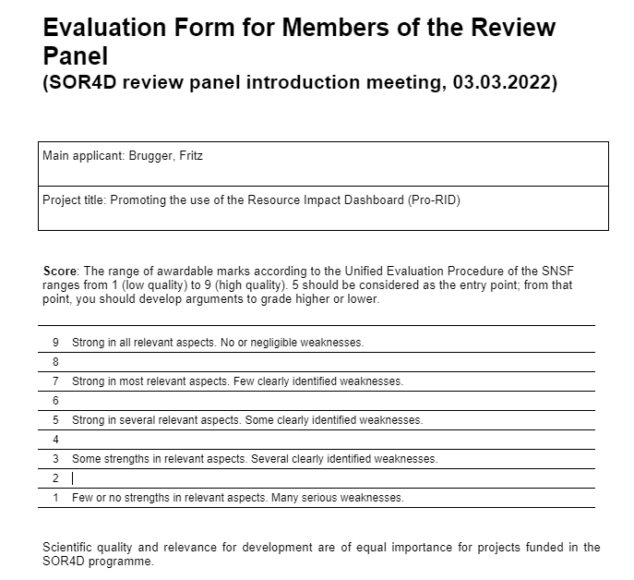
r4d TAG Resource Impact Dashboard (2019-2021)

